Slide 1

Network Packet Analyzer and Traffic Monitoring Tool.
Presented by:
SRIDHARSHAN S – 192412311
DINESH KUMAR S – 192313001
SARAVANA YOGESH M - 192412273
Supervised by:
Course faculty : Dr.V. JAYASUDHA

Slide 2


Introduction
A computer network continuously exchanges data in the form of packets.
Monitoring these packets helps network administrators understand network behavior and detect problems.
This project implements a lightweight packet analyzer using C programming and the libpcap library to inspect packet headers.
Unlike standard terminal-only sniffers, our project bridges low-level network packet capture with a modern, real-time web dashboard.

Slide 3
Problem Statement & Objectives
Problem Statement
Traditional network monitoring tools are often complex and require significant system resources. There is a need for a lightweight packet analyzer that demonstrates how network traffic can be captured and analyzed efficiently using the C programming language.
Objectives:
Capture live network packets using a custom C program.
Analyze Ethernet and IP headers to extract Source IPs, Destination IPs, and Packet Lengths.
Store packet logs efficiently for rapid data transfer.
Display packet details in a real-time, user-friendly graphical dashboard

Slide 4
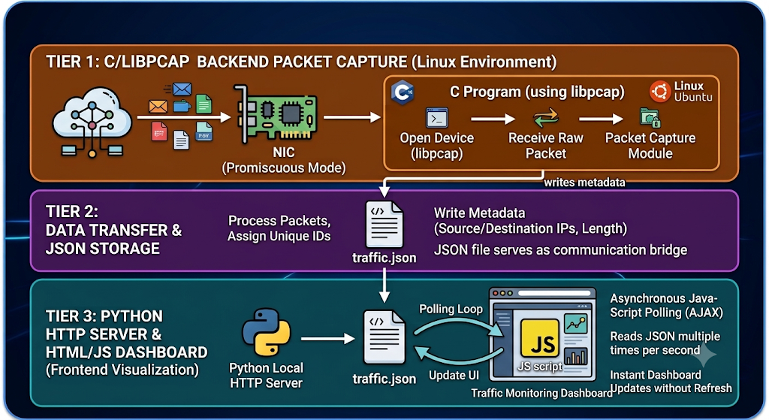
System Architecture

Slide 5
Technologies & Implementation
Software & Environment Used:
Backend Environment: Windows Subsystem for Linux (WSL) - Ubuntu
Backend Programming: C Programming, GCC Compiler, libpcap library
Frontend Technologies: HTML5, CSS3, Vanilla JavaScript
Web Server: Python 3 HTTP Server
Programming Concepts Applied:
C Concepts: Structures, Pointers, Functions, File Handling (JSON generation).
Networking Concepts: Networking APIs, Packet Header parsing.
Web Concepts: Asynchronous fetch() requests and DOM manipulation.

Slide 6
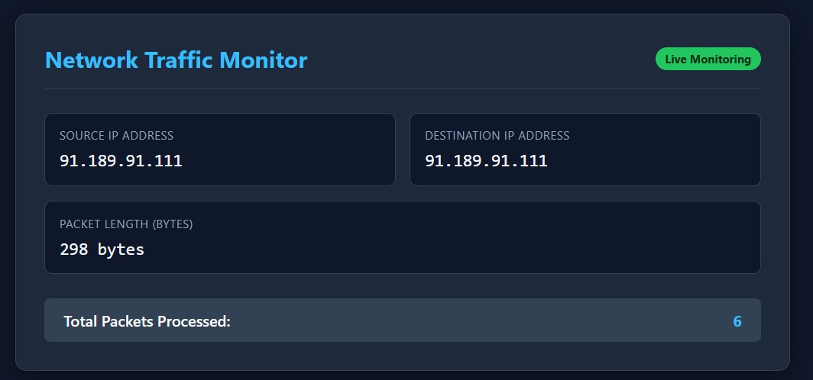
Output
Backend Terminal Output:
Real-time console logging displaying: Packet ID Captured: Source IP -> Destination IP.
Silent, continuous generation of the traffic.json log file.
Frontend Dashboard Output:
A dark-themed, responsive web interface indicating "Live Monitoring".
Dynamic display of the active Source IP Address and Destination IP Address.
Live tracking of the individual Packet Length (in Bytes).
A high-speed counter tracking the Total Packets Processed during the session.

Slide 7
Conclusion & Future Scope
Conclusion:
Successfully developed a real-time packet analyzer using C and libpcap.
The system successfully captures and analyzes live network traffic and displays packet information dynamically.
Demonstrates practical applications of computer networking and C programming by linking system-level operations with web-based data visualization.
Future Scope:
Implement packet filtering to isolate specific TCP, UDP, or ICMP traffic.
Add live bandwidth traffic visualization using dynamic graphs.
Add a historical packet log table directly into the web interface.
Implement Network Intrusion Detection capabilities to flag suspicious IPs.

Slide 8
THANK YOU

